Slide 1
Scotchmans Creek State of the River Report
FRIENDS OF SCOTCHMANS CREEK
AND VALLEY RESERVE INC.
Rex Dusting
Presentation to FSCVR Members Meeting 19 May 2021

Slide 2
Topics
Overview of Scotchmans Creek
Topography / History / Catchment Characteristics
Condition Report as we take a walk down the creek
Reflections on Past Achievements & Future Challenges
Acknowledgements:
Photographs taken by past and current members
Notes:
Major source for photographs are from Ted Mason, Fred Bulloch and Tony Walker

Slide 3
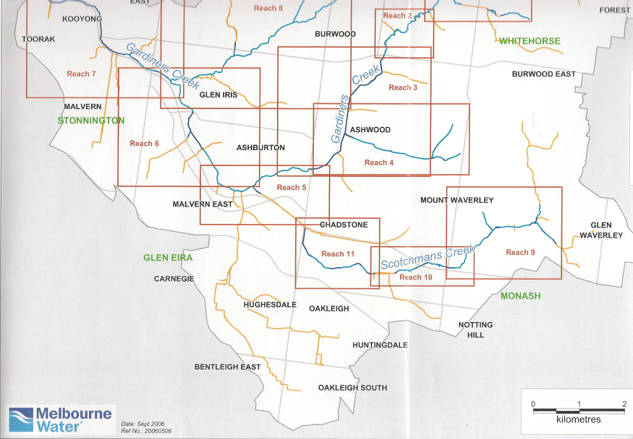

Slide 4
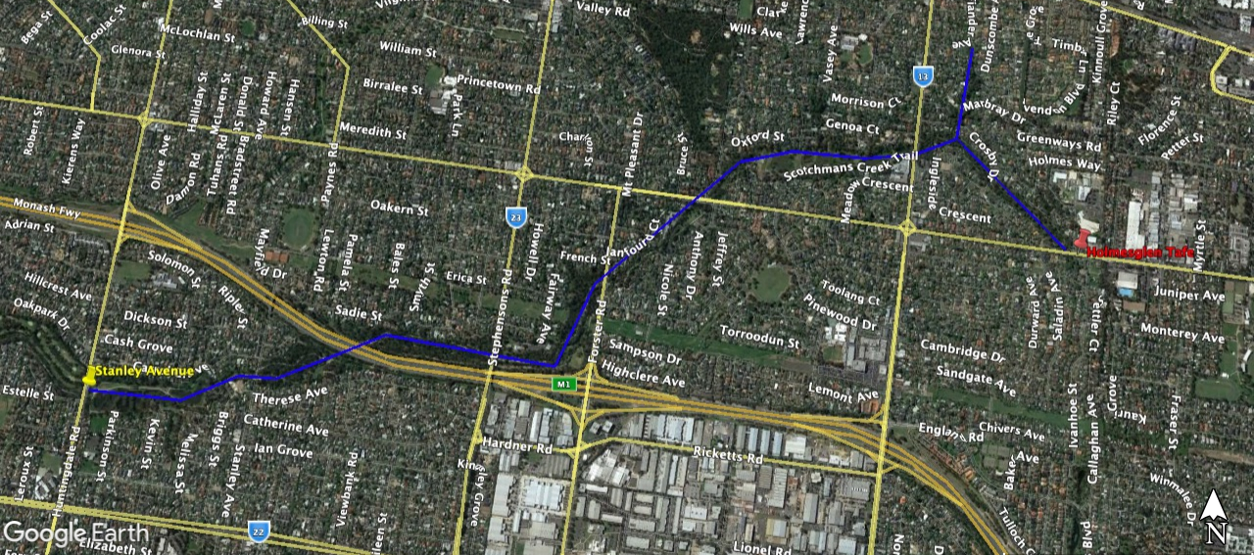
Stanley Ave.
Waverley Rd
Blackburn Rd
Stephensons Rd
Notes:
Reminder:
Scocthmans Creek rises in the urban drainage system under Glen Waverley and Syndal areas
The friends of Scotchmans Creek and Valley Reserve look after the section from where the drainage system daylights in Waverley Road and near Fiander Street through to Stanley Avenue just west of Huntingdale Road.
As can be seen the area ia heavily urbanised which of course heavily influences the nature of the stream.
Prior to European settlement the area would have been lightly wooded with a lot of in stream vegetation . This would have resulted in stream lines much less well defined, swampy pools, gently flowing streams.

Slide 5
Blackburn Rd
Stephensons Rd
Waverley Rd
Notes:
This is an aerial photograph from 1945.
Area has been largely cleared and land used for agriculture
Road labels are current names which helps with orientation.
Clearly see Valley Reserve retaining some natural vegetation. Streams can be seen – because largely still rural the streams would have been narrow and some instream vegetation remains but majority of vegetation right up to the creek has been removed.
Other observations:
Golf course in Crosby Dve area,
Fiander Arm north towards Syndal
Valley Creek
Other streams that are now underground drains –pinewood area
Water Supply Pipeline
Regent Street just a track

Slide 6
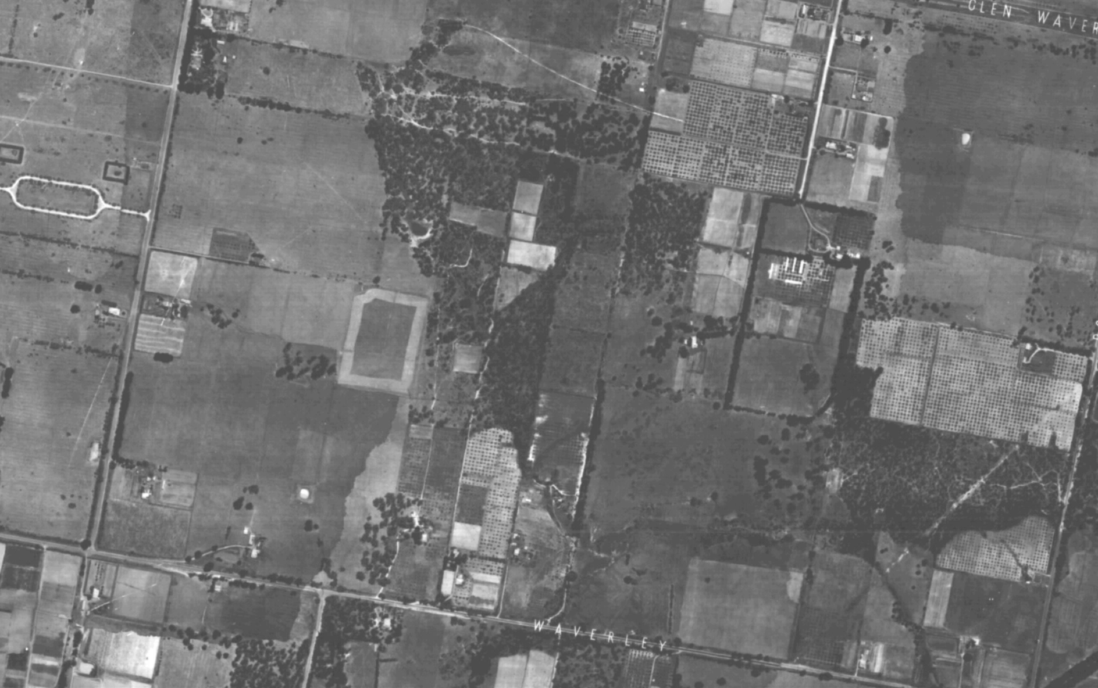

Slide 7
Effects of Post War Development
Notes:
By the early 70s the area has been transformed by urban development
Rapid run off from the paved areas has created the current form where the stream has been eroded to form step sided banks. Rapid run-off also has engineered with bank protection to control further erosion and flood management works.
For flood management purposes the current reserves that run along the creek had been created . Areas were used for passive recreation. Small pockets of residual bush remained by default. Other than mowed areas large areas devoid of vegetation or with environmental weeds.
Photos Curtesy of Fred. Showing Glen Waverley Main Drain Section early 80s and current wetland area west of Blackburn Road mid 80s.

Slide 8
Taking A Walk Down the Creek
Notes:
We are going to take a walk down the creek
As we go I am going to describe the current state of the creek. I have divided our part of the creek into 6 different reaches and in each reach I’ll point out what are the its characteristics, what are its good features and its challenges.
The creek has its challenges and opportunities but you will see how the stream & surrounds have been improved over the years – much of it due to Friends efforts.
After I have taken the walk I’m going to open the meeting up to you all to talk about the thought, reflections, and memories of those improvement efforts.
I have a few slides to help us reflect as well.

Slide 9
Reach 1 Waverley Road to Blackburn Road
Blackburn Road
Waverley Road
Notes:
Consists of 2 sections
– running west from Waverley Rd branches officially known as Glen Waverley Drain. As reported in past Friends of Scotchmans Creek and Valley Reserve have made representations to change the name. Process is not simple but place names are Gazetted and process requires regulation change.
Coming from the north the fiander Arm
Upstream of this section the Creek is fed by council drain network catching run off from residential and light industrial development extending to the ridge Glen Waverley / Wheelers Hill ridge.

Slide 10
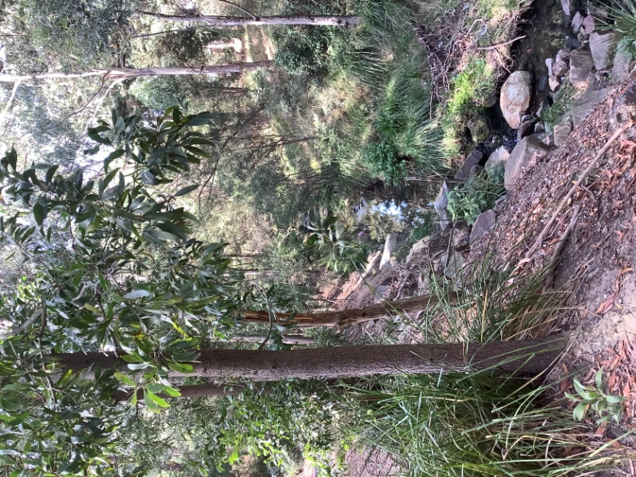
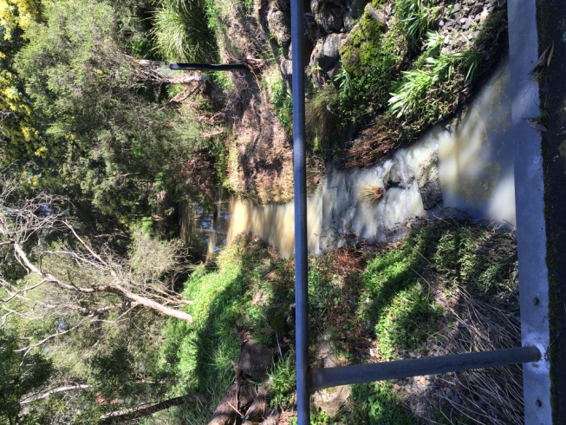
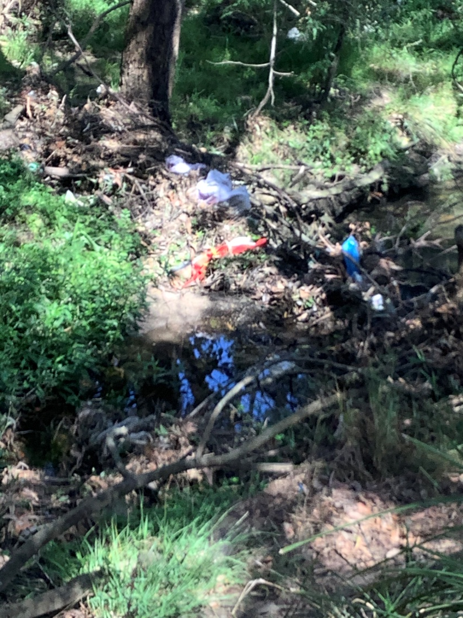
Reach 1: Waverley Road to Blackburn Road
Turbidity
Instream weeds
Steep sided valley driven by erosion
Litter
Notes:
One of the poorer lengths of stream reflecting the effect of upstream conditions upstream - paved areas, light commercial, with steep banks, erosion, litter, past episodes of dumping upstream

Slide 11
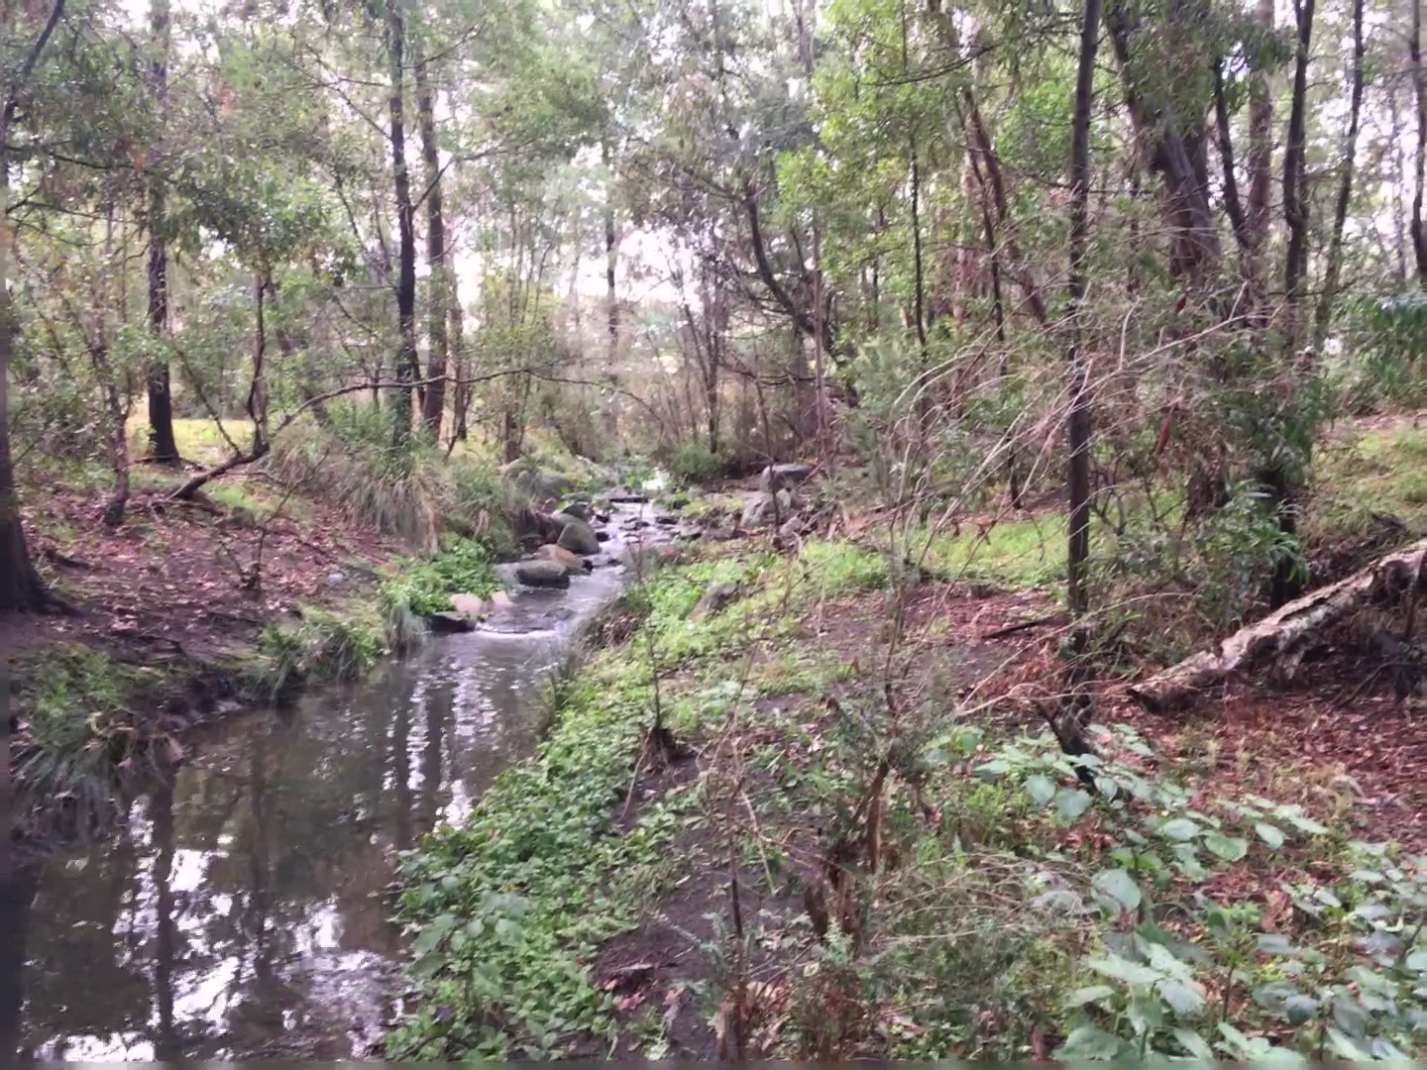
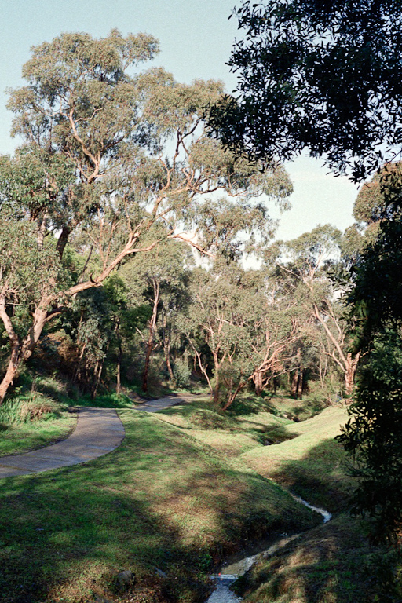
Upstream Crosby Dve 1986
Vicinity of Crosby Dve 2020
Notes:
However its important to reflect how big improvements have been made.

Slide 12
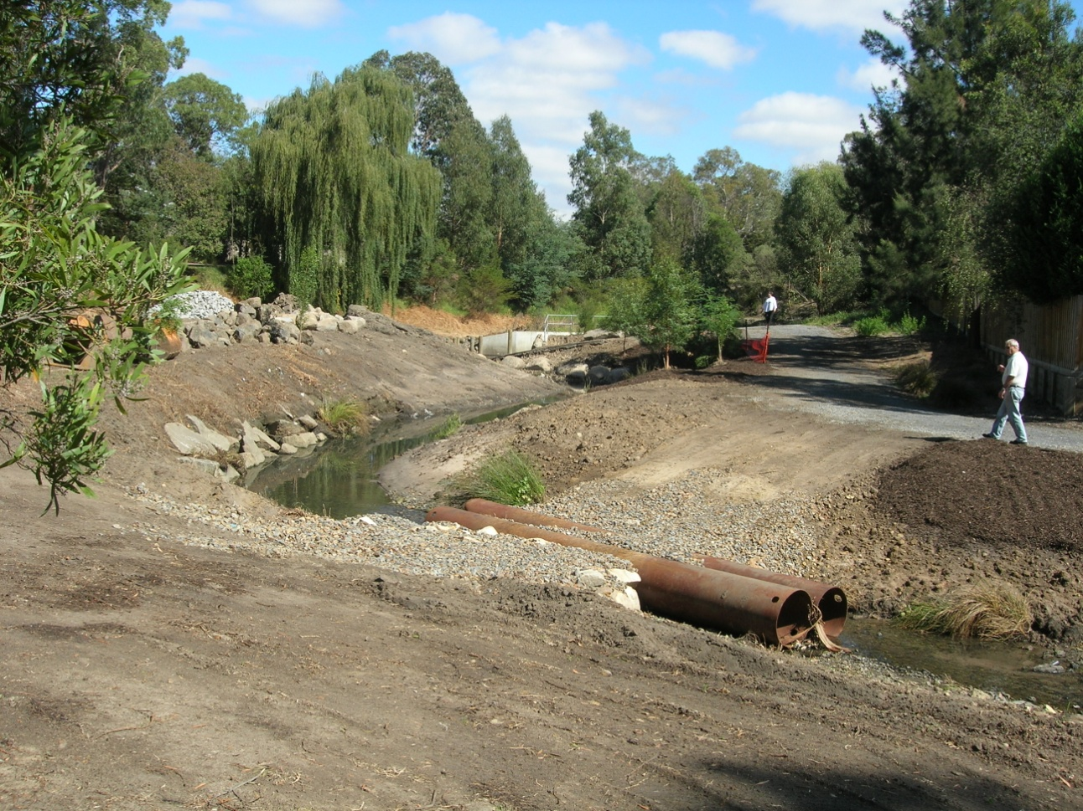
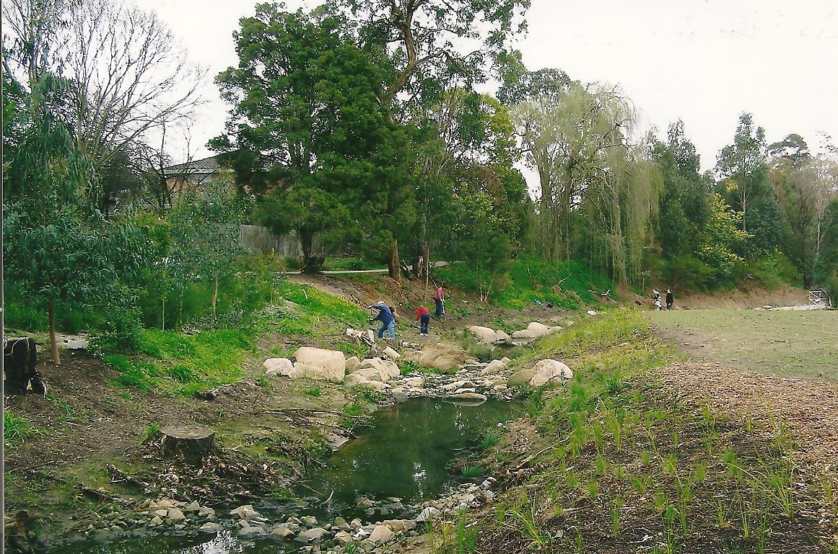
Remedial Efforts Upstream of Blackburn Road

Slide 13
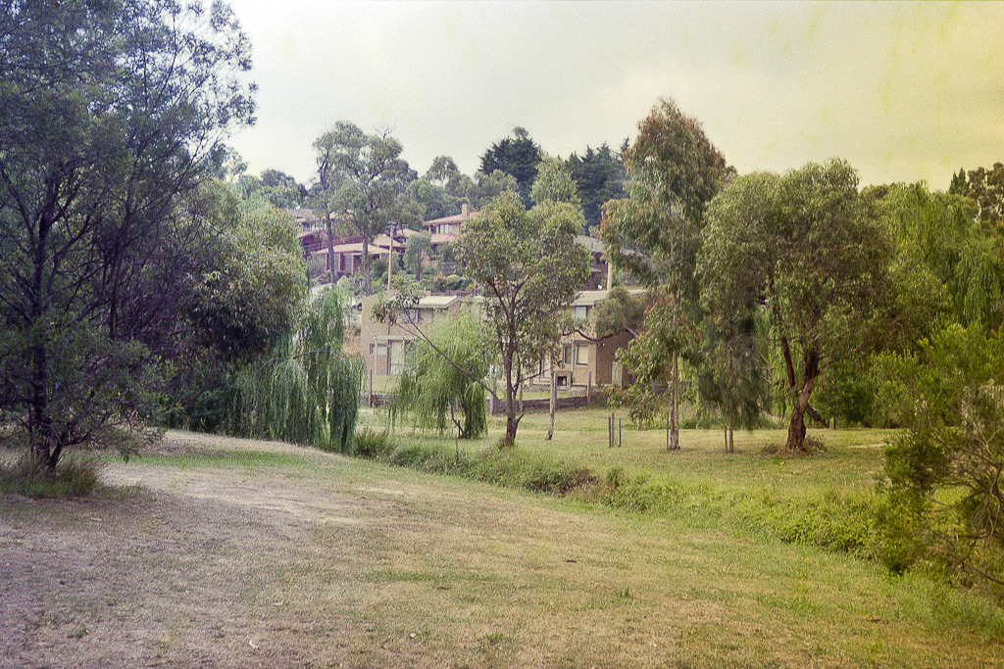
Fiander Arm & Junction With GW Drain 1985

Slide 14
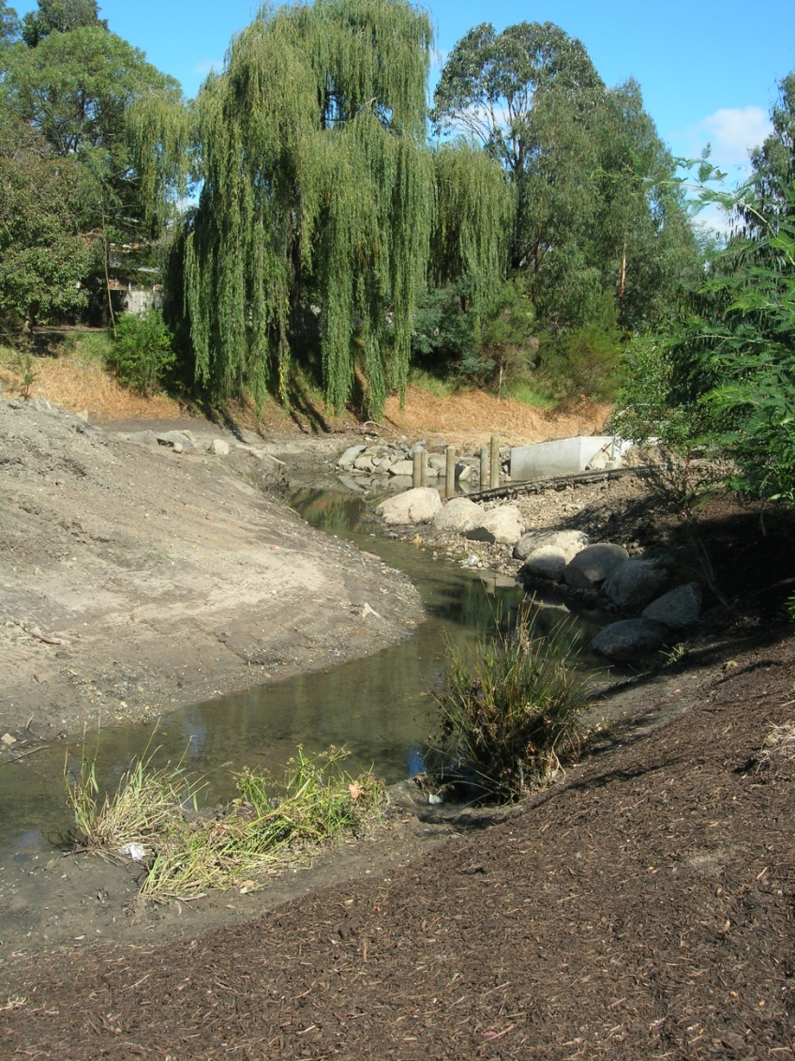
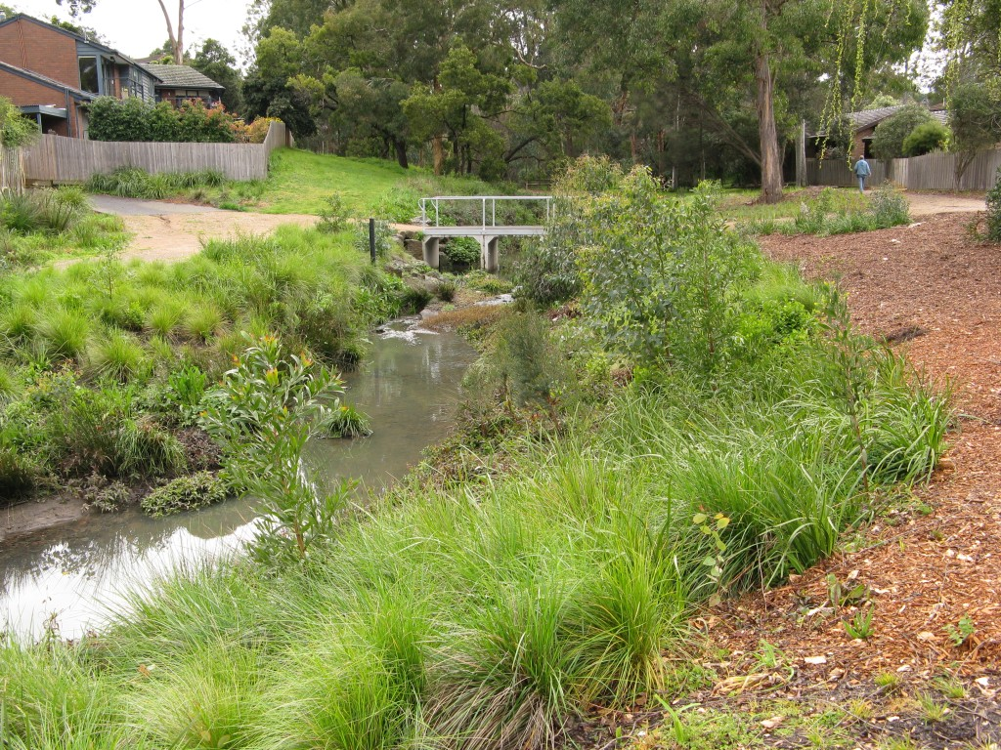
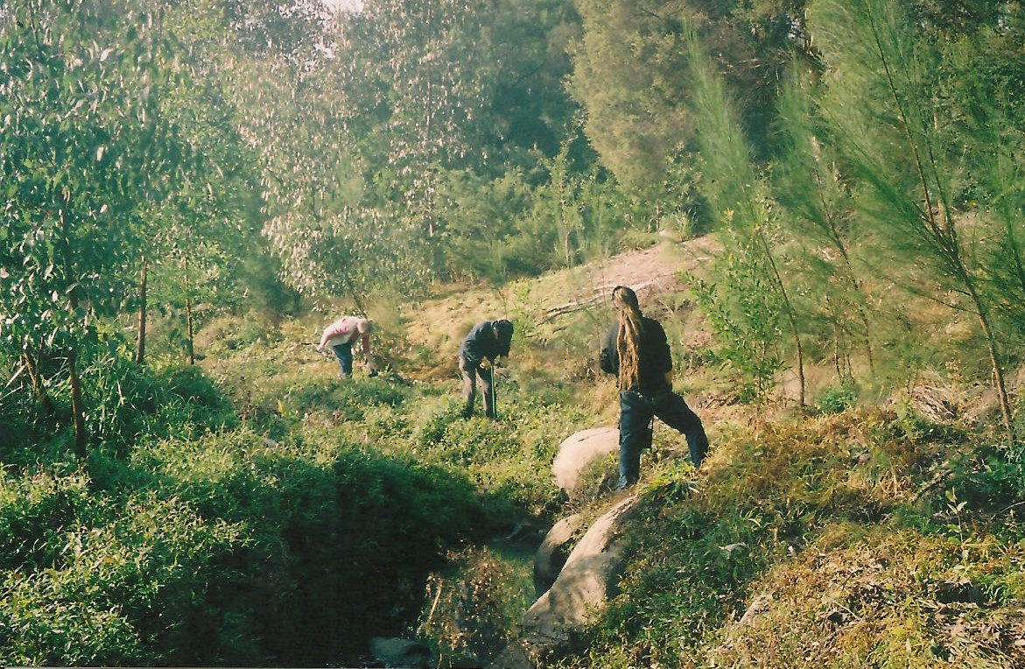
Fiander Arm & Junction With GW Drain

Slide 15
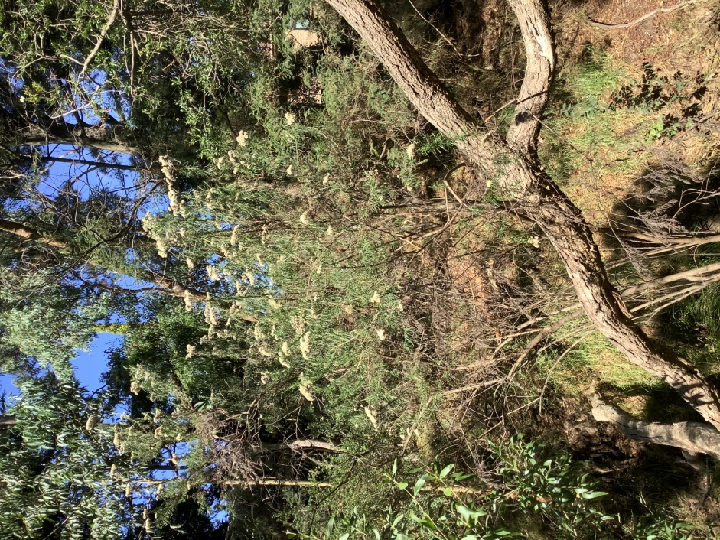
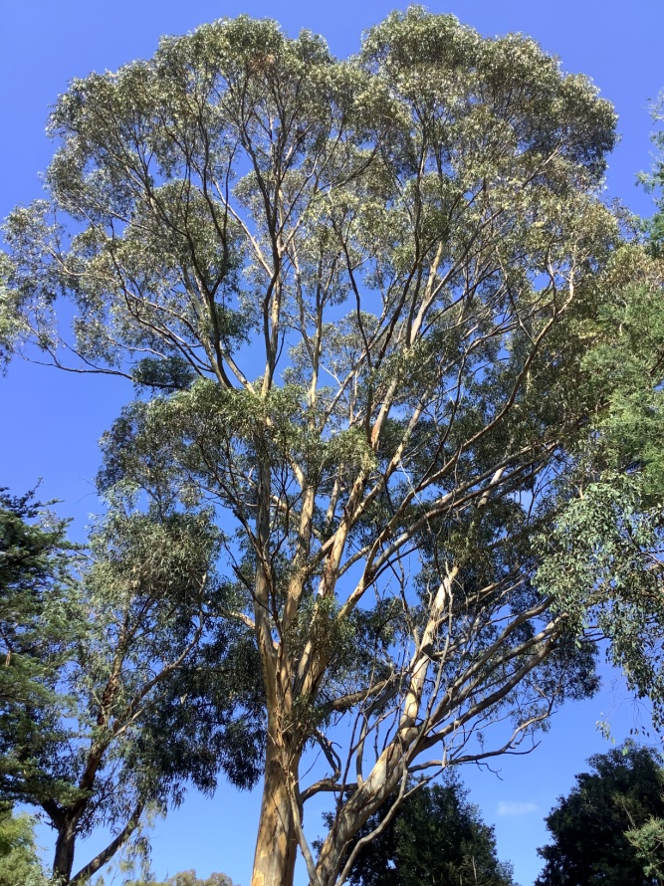
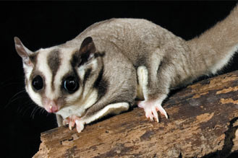
Corridor Now Has a Diverse Range of Vegetation Supporting Wildlife
Notes:
Now a diverse array of vegetation planted, Requires continuing planting efforts and weed management to support healthy undergrowth..
Reports from Council bush crew of sugar gliders active in this reach with habitat meeting their needs.
However those instream challenges remain.

Slide 16
Reach 2 Wetland Retarding Basin Downstream of Blackburn Road
Waverley Road
Waverley Road
Blackburn Road
Forster Road

Slide 17
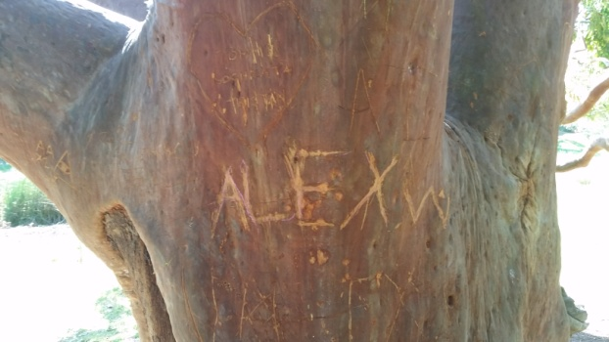
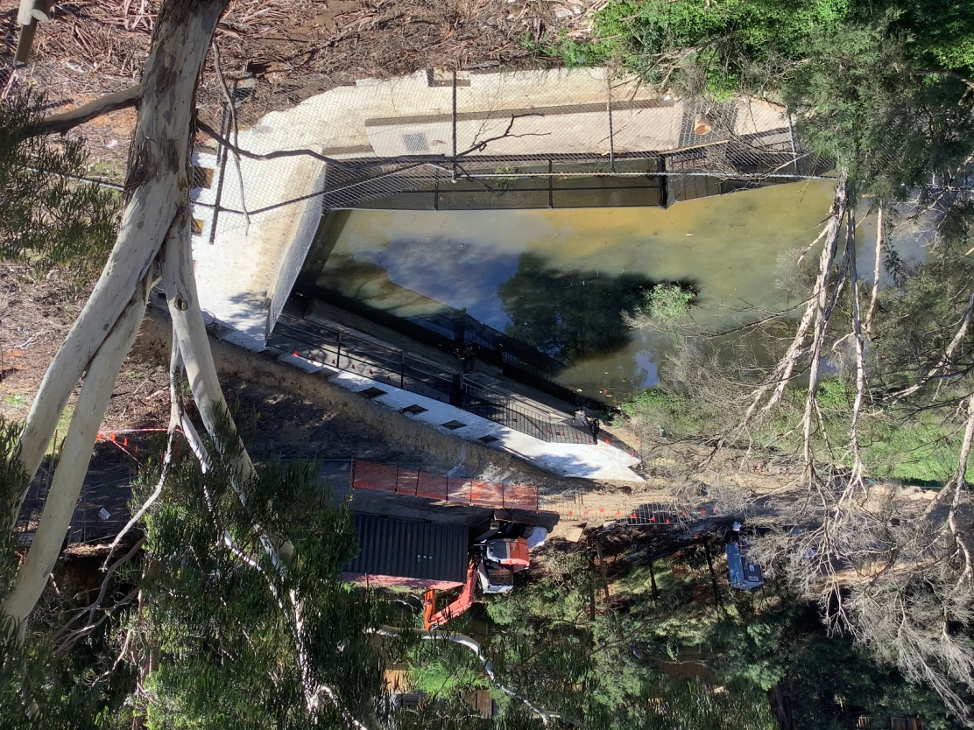
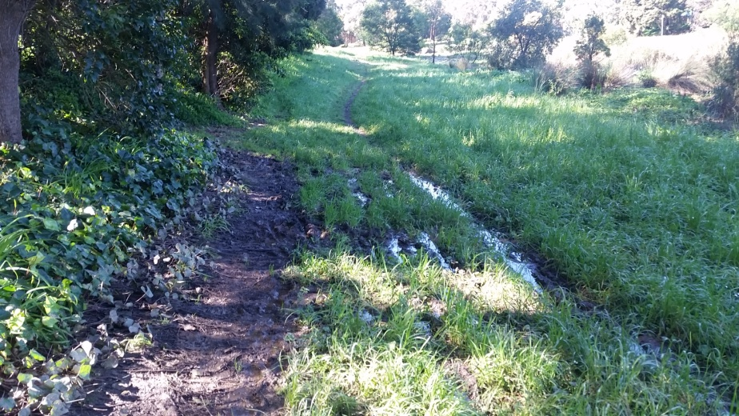
Reach 2: Wetland D/S of Blackburn Rd
Popular accessible corridor
Mixed vegetation.
Constructed Flood management wetland
Notes:
Wetland downstream of Blackburn Road managed by Melbourne Water primarily for its engineering functions to control stormwater flows, provide treatment and easement for water supply and sewage pipework.
Relationship with Friends is positive – eg recent consultation on reconstruction of headwalls on Blackburn Road to remove Health and safety hazards.
Also popular accessible space under heavy pressure last year during lockdown..
Under pressure from weeds particularly on northside.. Gaps in vegetation. Friends working with MW to do small planting this year near Lawrence Rd. And also discussions on increasing planting in other areas.

Slide 18
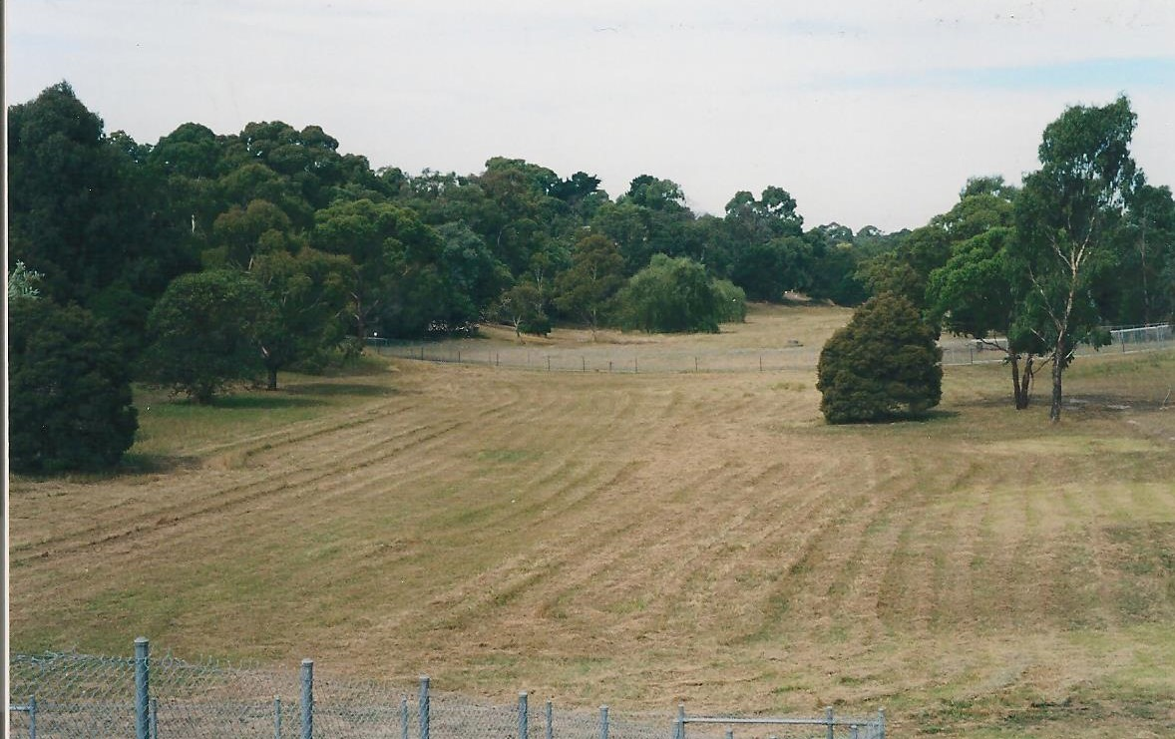
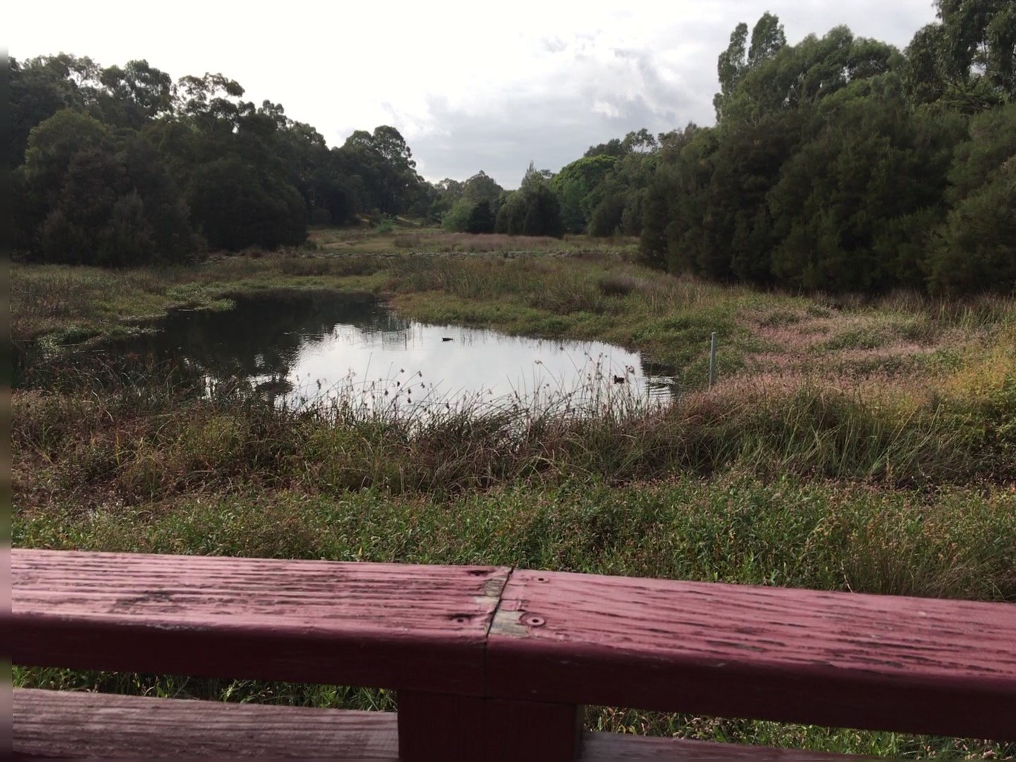
Site of Lawrence Rd Bridge May 2004
Lawrence Road Bridge 2020
Notes:
2004 Open grassland floodway. Trees assortment of exotics and natives
2020 Wetland treating stormwater to remove nutrients, sediments and trap litter and supporting frogs, water birds.
Banks planted with exotics but room for further plantings and improvements

Slide 19
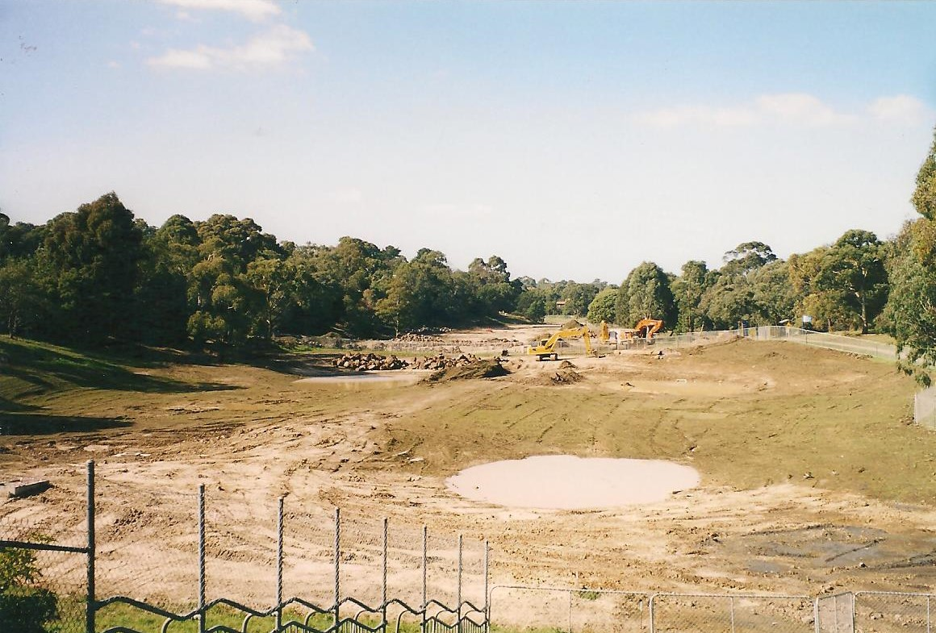
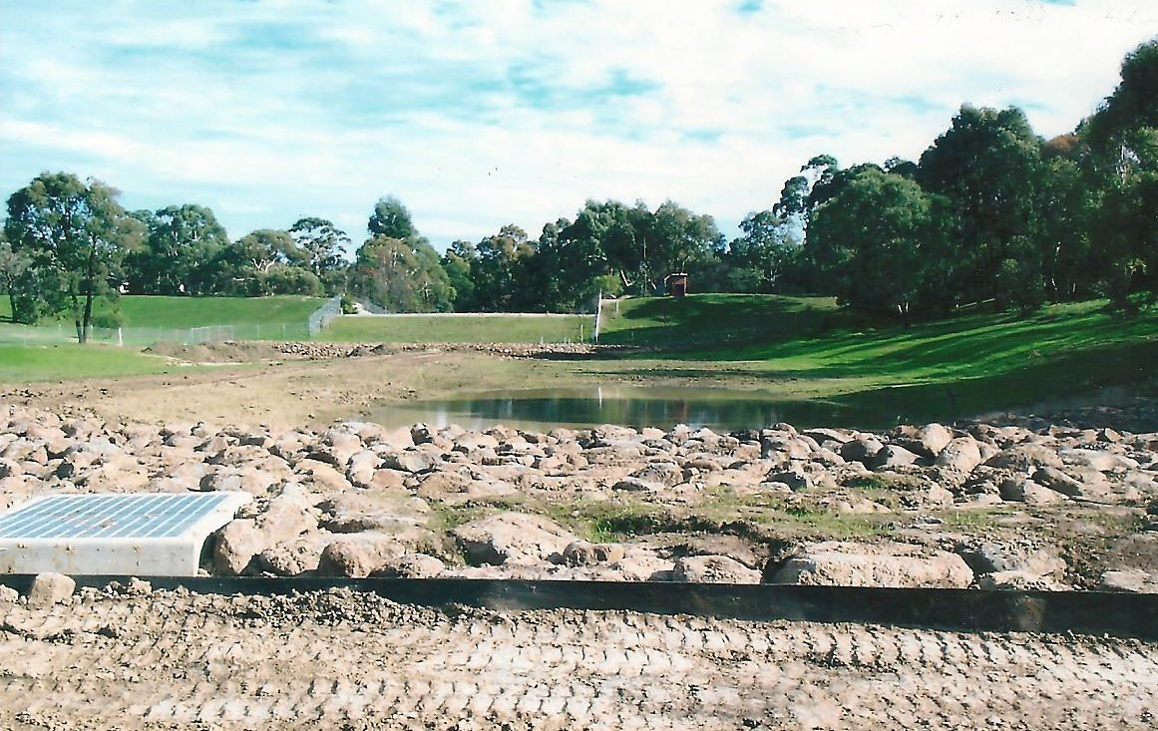
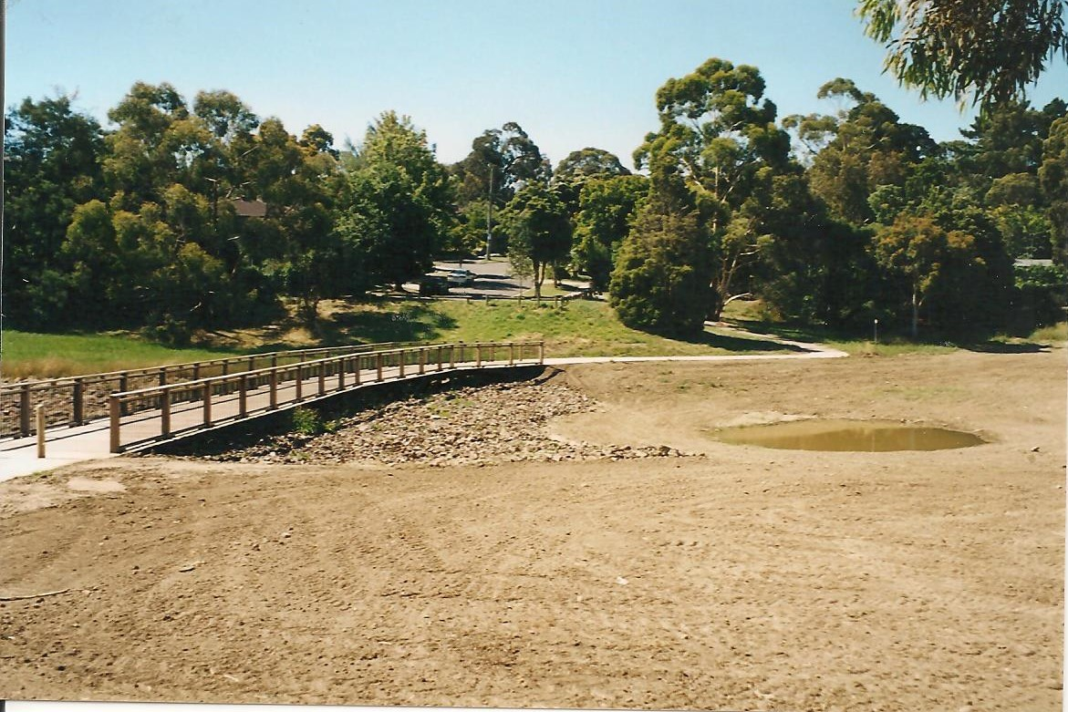
Wetland Construction 2004

Slide 20
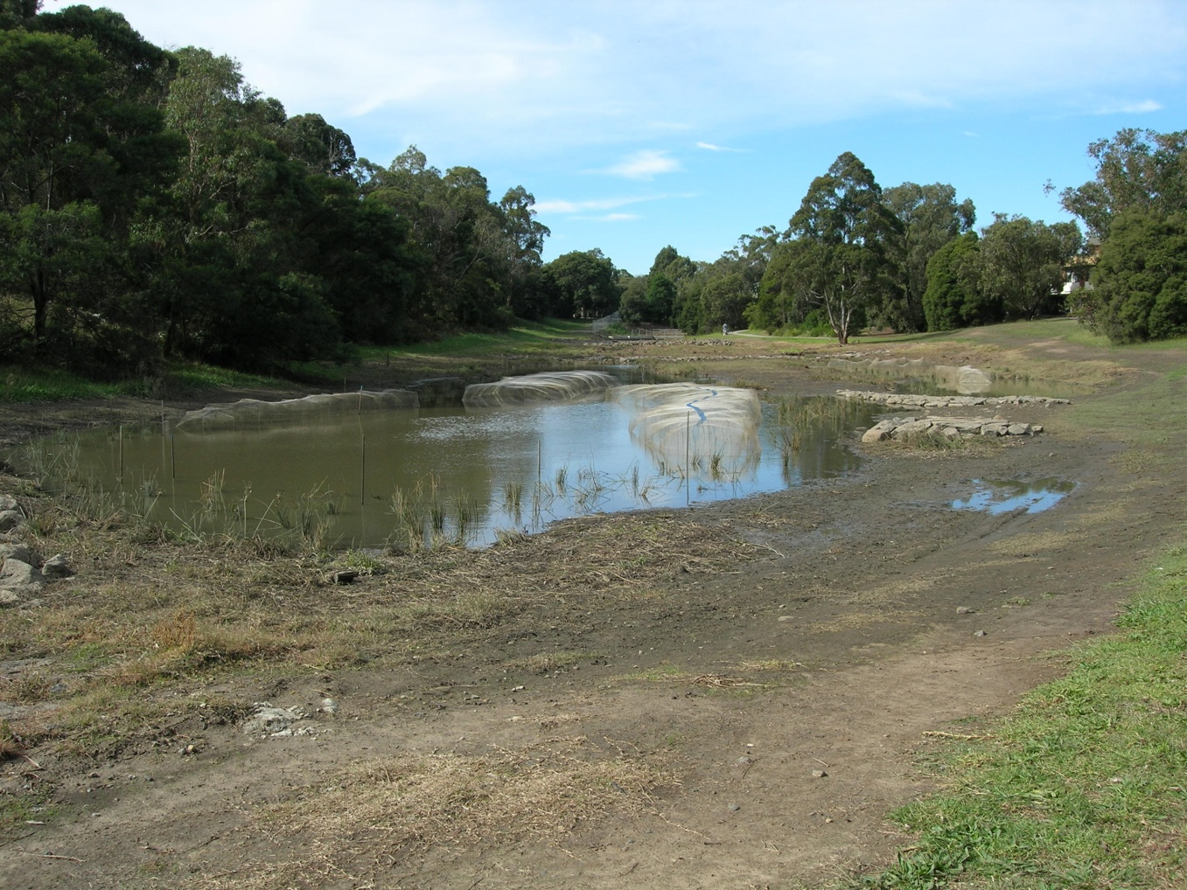
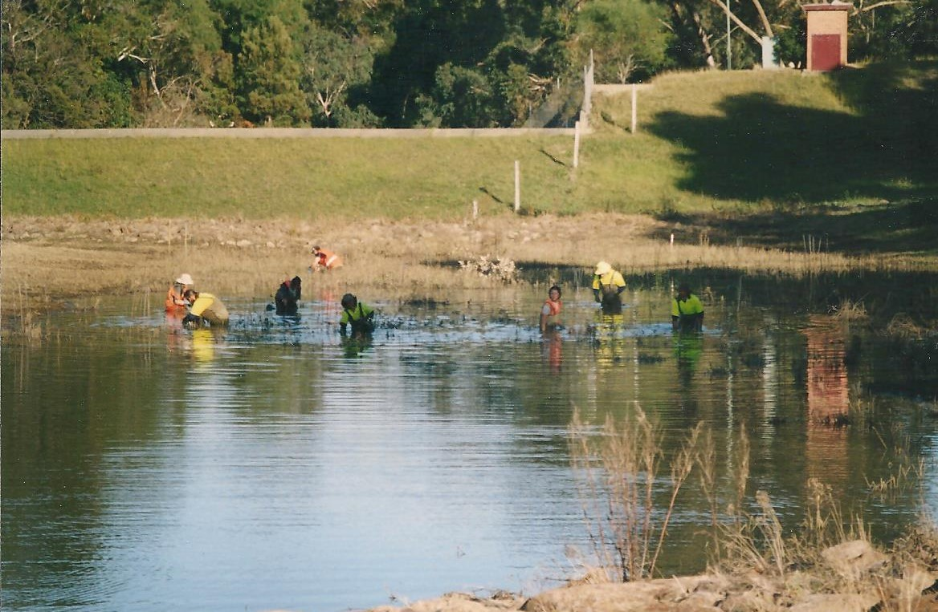
Wetland Planting 2006

Slide 21
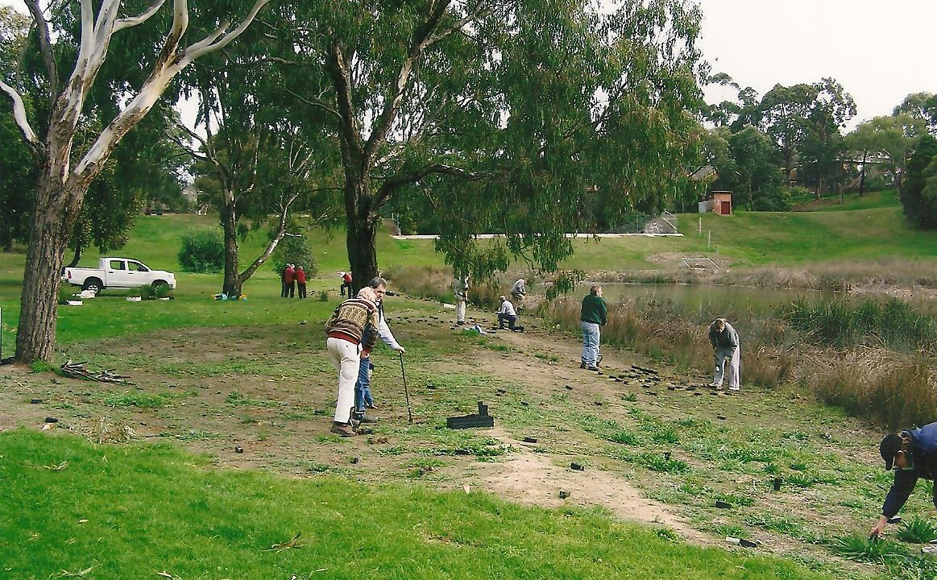
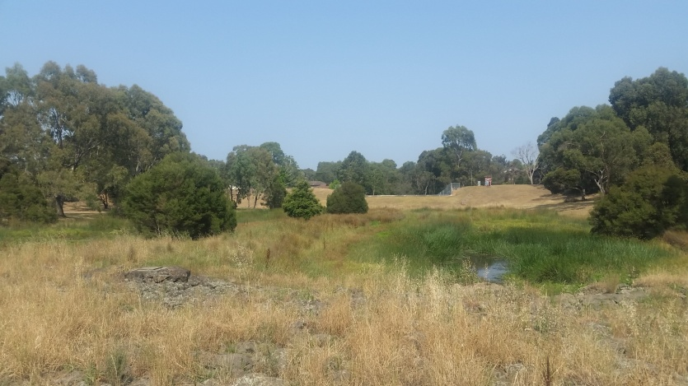
Friends Planting in Corridor 2008
January 2020

Slide 22
Reach 3 Regent St (Basin Wall to Waverley Rd & Valley Creek)
Waverley Road
Blackburn Road
Forster Road

Slide 23
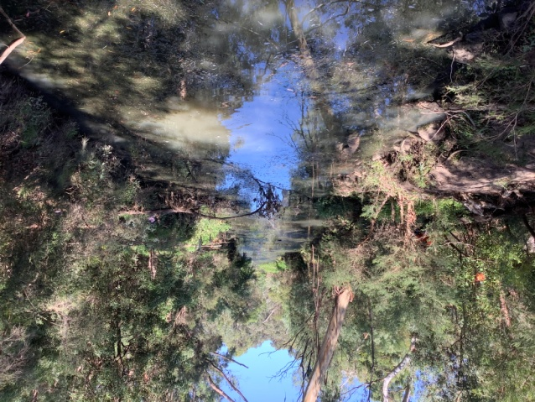
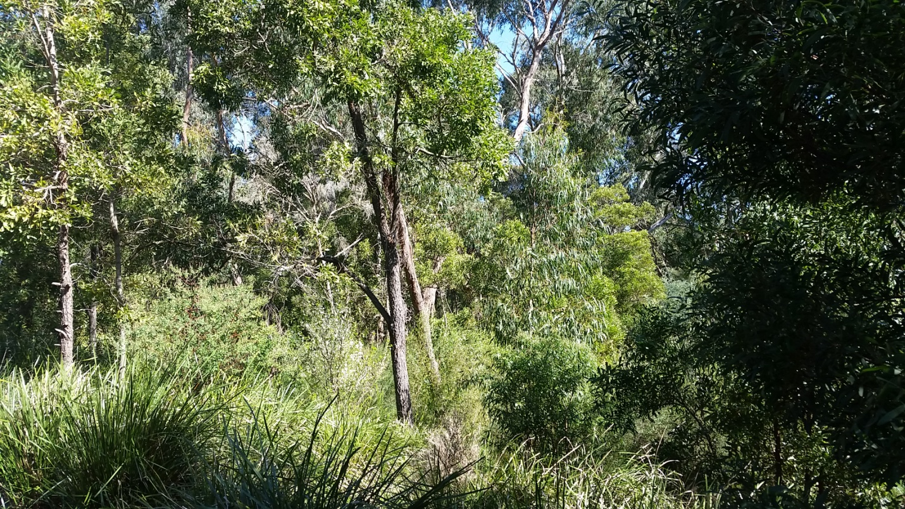
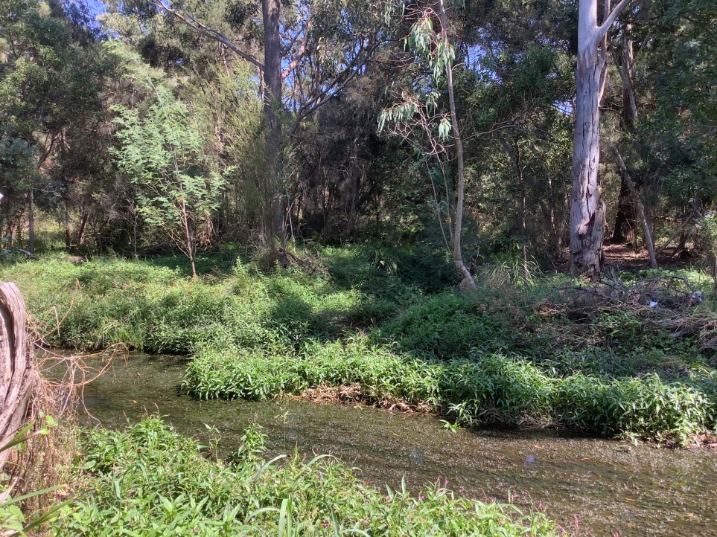
Reach 3: Regent St (Basin Wall to Waverley Rd)
Tranquil flow, water birds, and variety of other bird life and other aquatic wildlife, flourishing vegetation.
Intermittent water quality and weed issues
Notes:
Attractive stretch..
Possibly closest Reachhto pre-European appearance now but wasn’t always so.

Slide 24
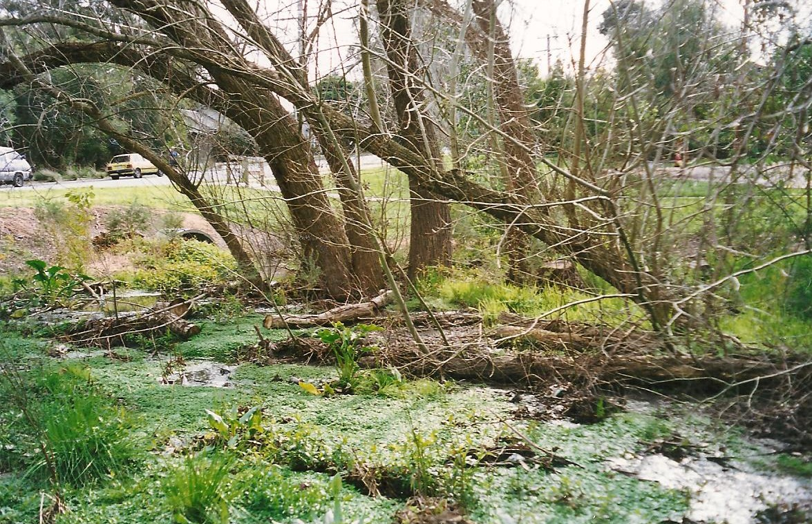
Valley Creek at Regent Street February 2001
Notes:
Major battles to remove the Willows

Slide 25
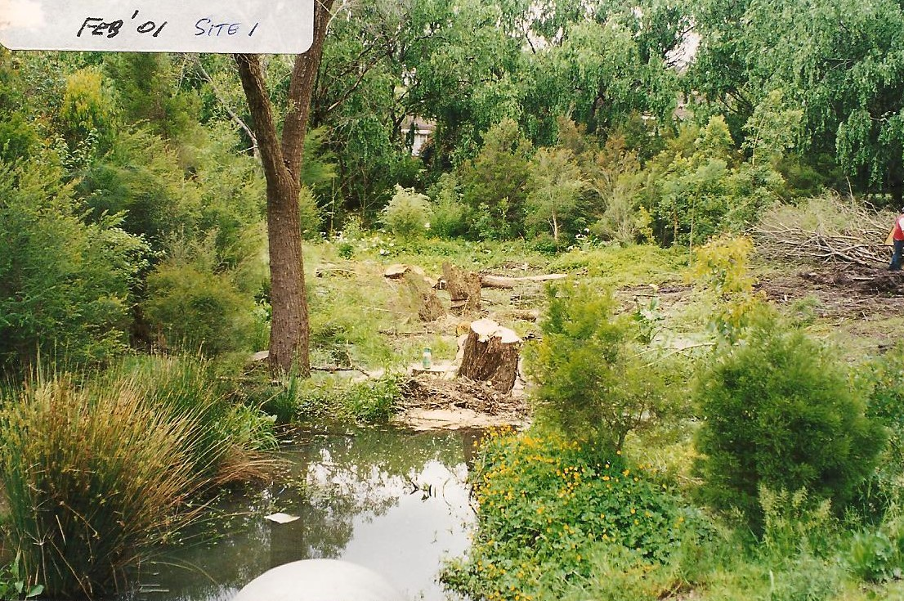
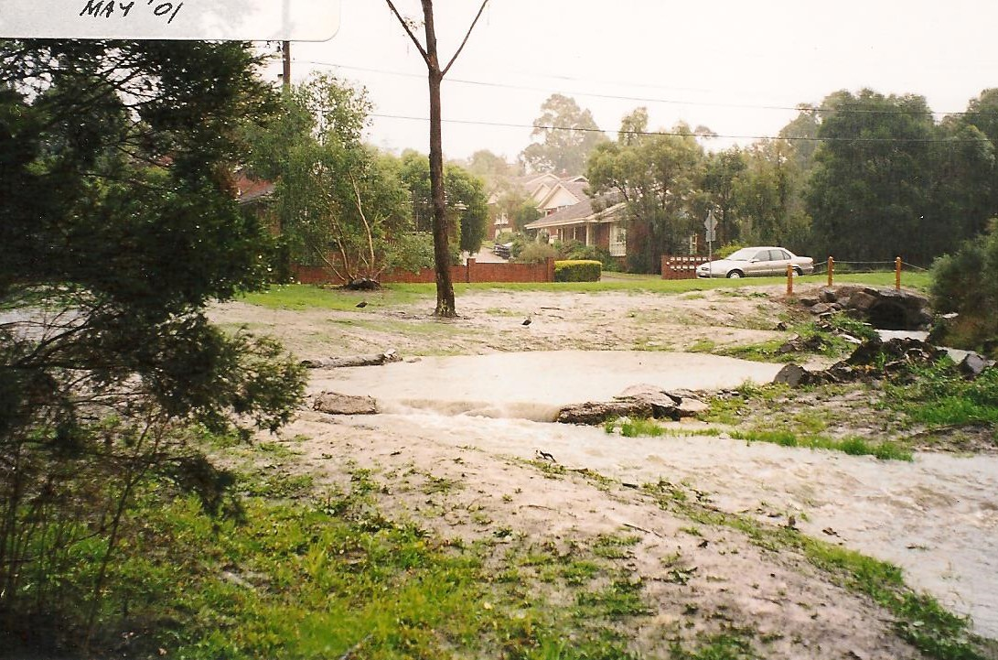
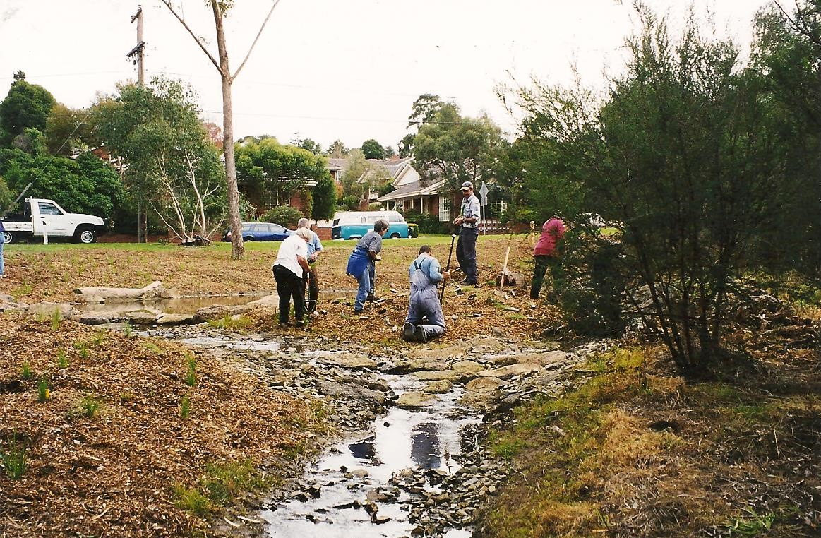
Valley Creek Rehabilitation 2001
Notes:
Tree Removal by Melbourne Water?
Friends Join In

Slide 26
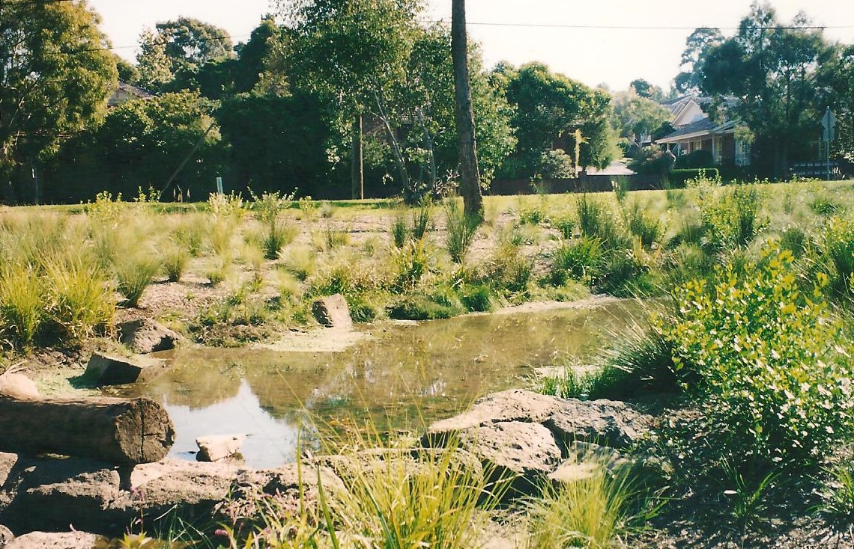
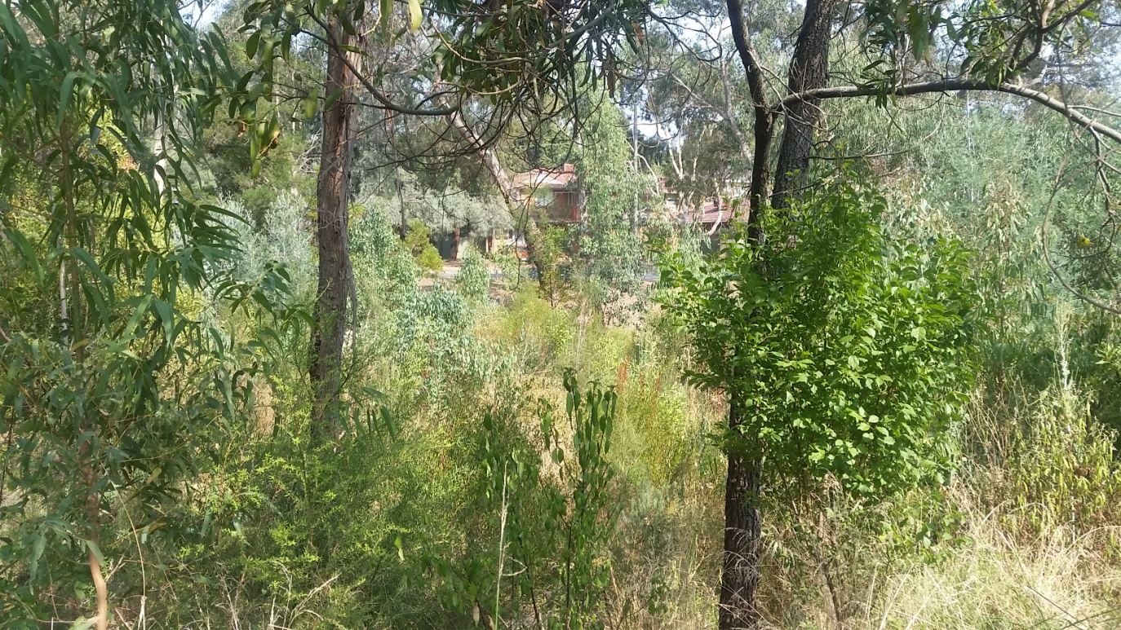
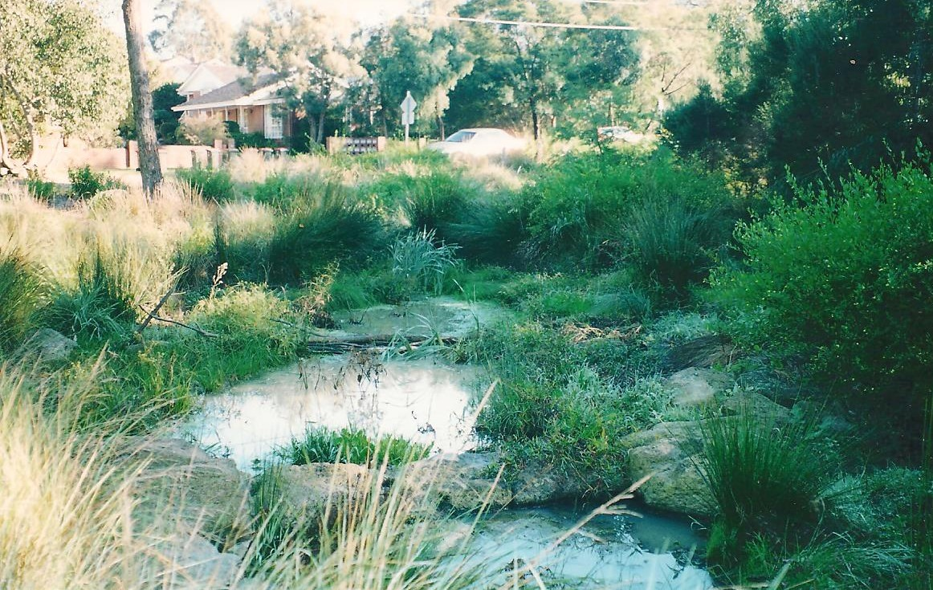
January 2020

Slide 27
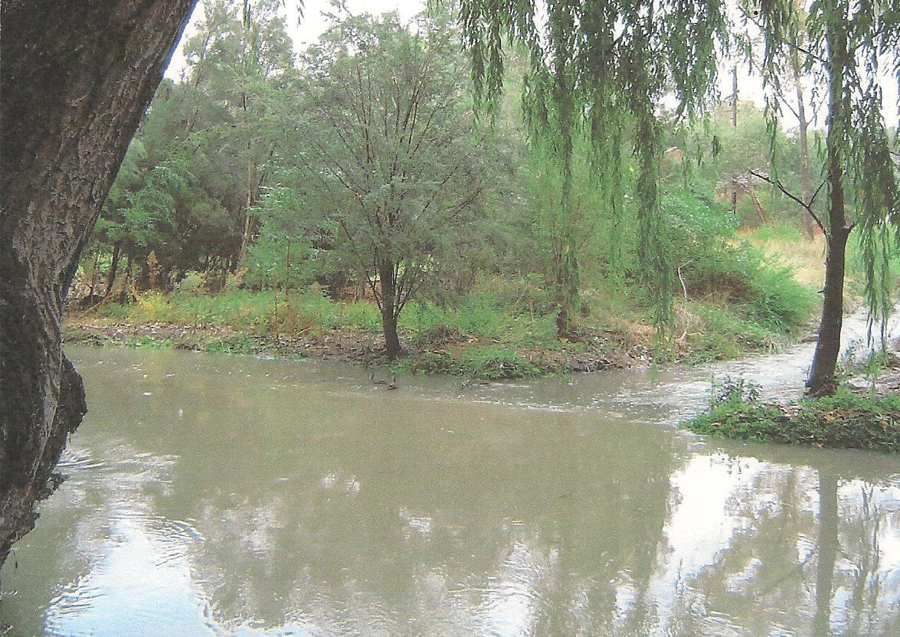
Junction with Scotchmans Creek
2005 Flood
January 2020

Slide 28
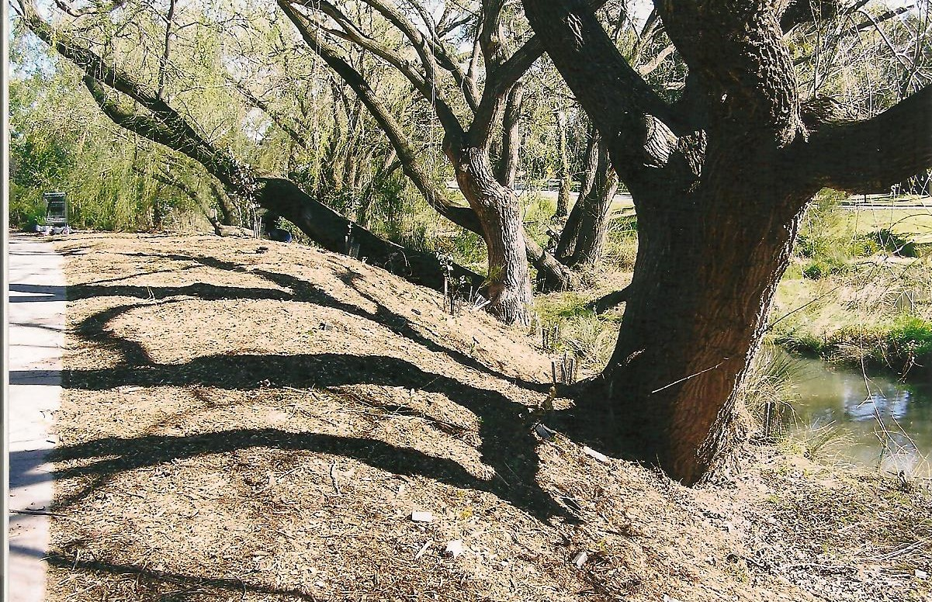
Willows on Scotchmans Creek 2008

Slide 29
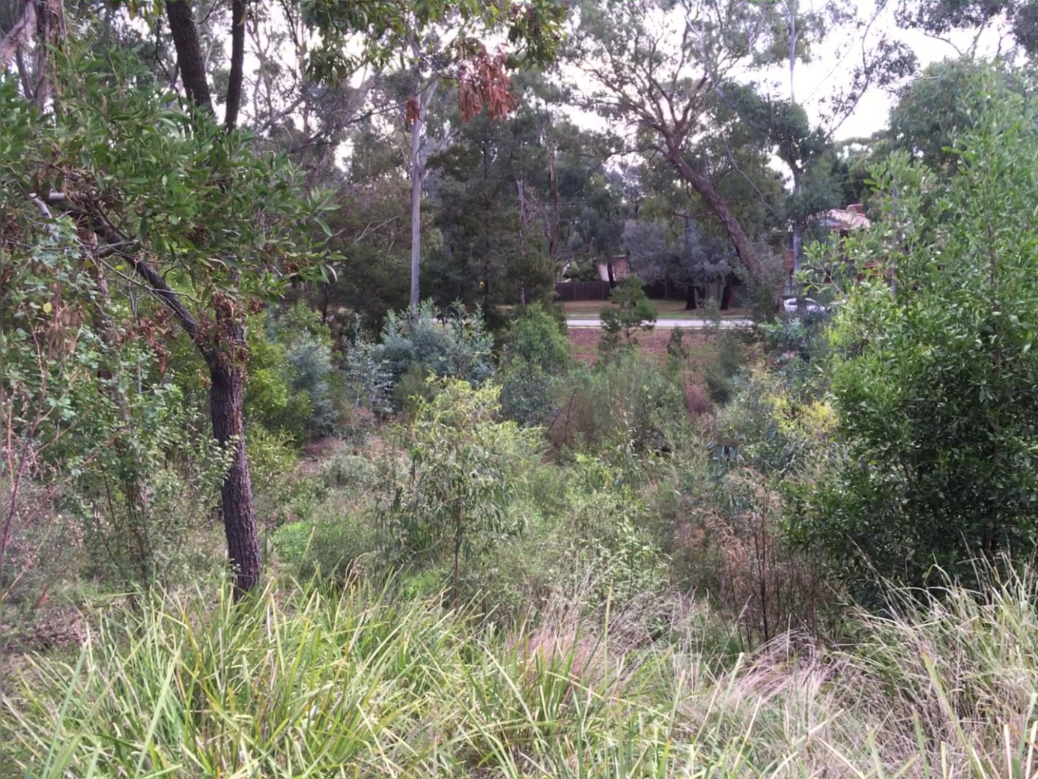
Current views of planted area

Slide 30
Reach 4 Waverley road to Forster Road
Waverley Road
Forster Road

Slide 31
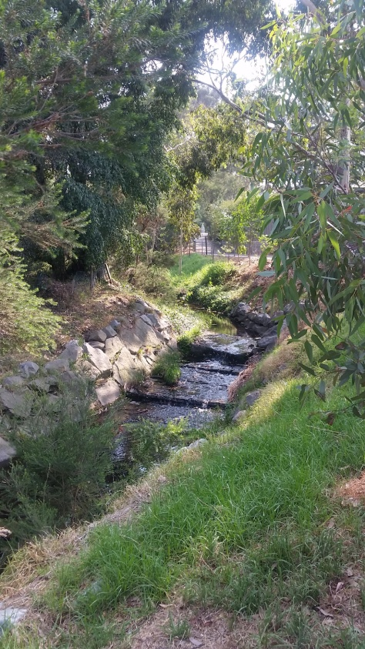
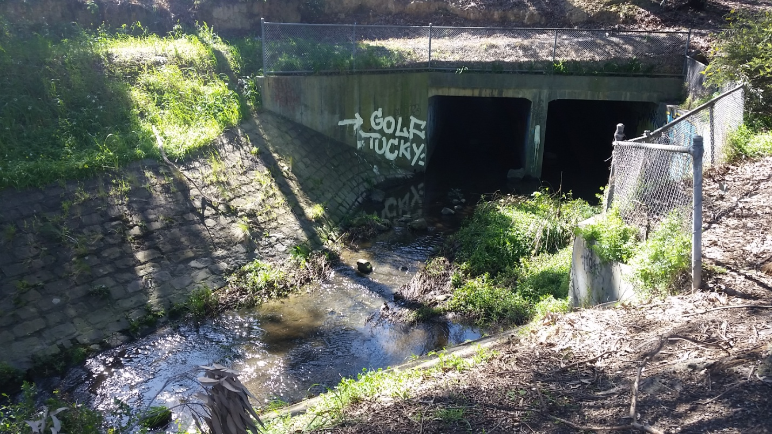
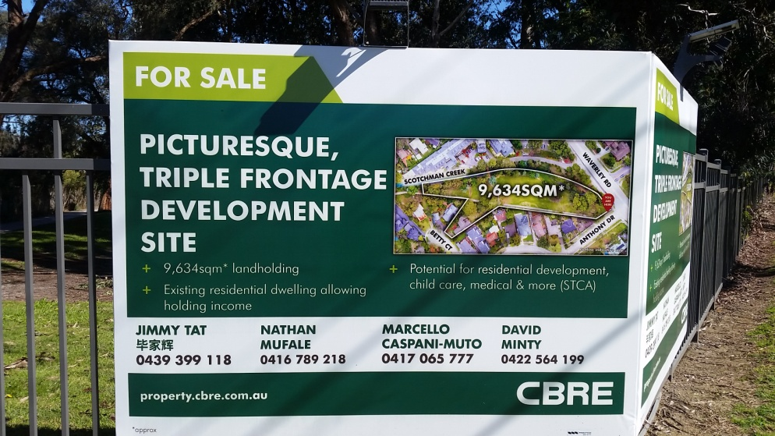
Reach 4: Waverley Road to Forster Road
Notes:
Relatively narrow strip of land on easement shared with Bike path. North side of creek adjoins private land holdings.
Creek back to deep channel with rock and concrete protection to prevent erosion and protect private property.
In open area near Waverley road Blue Cross sold land on south side & council created 10 m wide easement for bike path relocation. Council have feedback from developers that they are looking to have development which is sympathetic to reserve features. Focus on tracking this.

Slide 32
Reach 5: Forster Road to Stanley Avenue

Slide 33
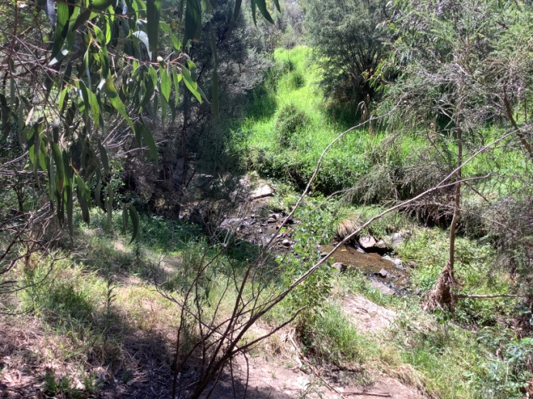
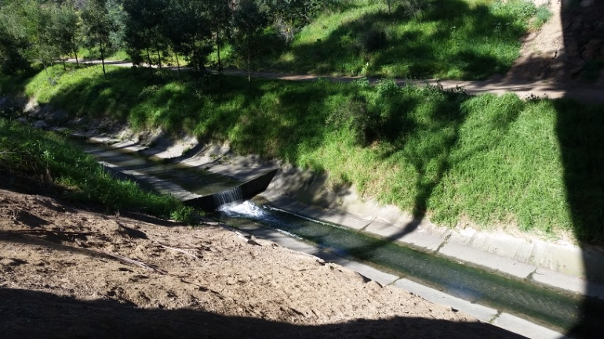
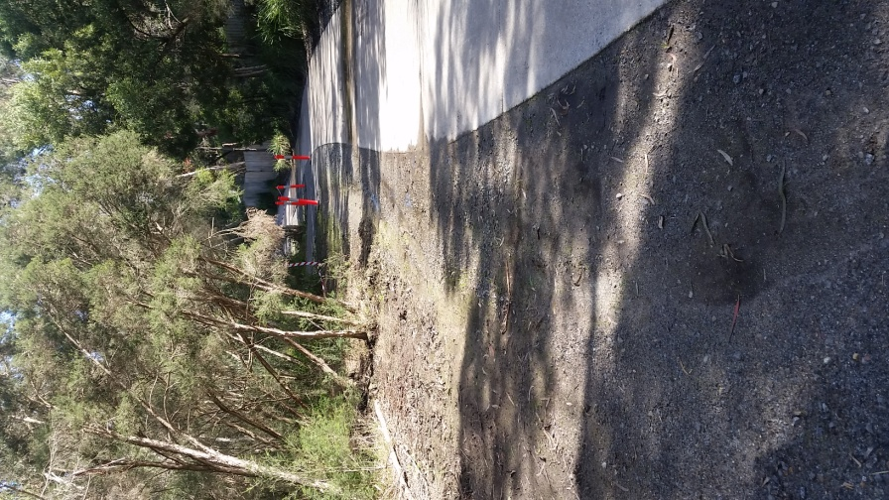
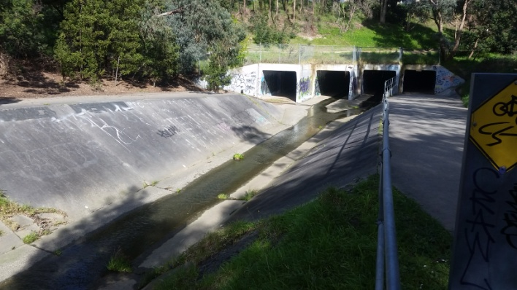
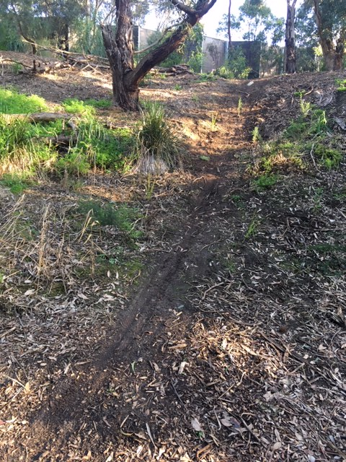
Reach 5: Forster Road to Stanley Avenue
Notes:
Creek continues the pattern of deep watercourse with lengths of constructed waterway, with some sections protected from erosion by rockworks and others by concrete lining. Freeway has a strong visual and noise impact in many areas.
Also heavily trafficked area which were impacted during the lockdown by “track widening” to avoid bikes and other people. Increased damage from bush bikes including damage to recently planted areas.
However wide area between housing on one bank and freeway on other has allowed signicant opportunities for replanting over the years to improve vegetation.

Slide 34
Notes:
However much of the reach now is in very good condition with diversity of vegetation attracting bird life. Some small areas of remnant vegetation that have been protected,
In spring good spot for viewing natives in flower.
Sufficient area for different path types – concrete commuter bike paths but also soft maintained bush tracks.
Friends focus is to continue with planting opportunities in the area, helping maintain a watching brief and early identification of damage.

Slide 35
Fairway Reserve - Scout Hall Plantings
2021
2003 & 2007

Slide 36
Fairway Reserve - Creek Banks
2003
2021

Slide 37
FRIENDS OF SCOTCHMANS CREEK
AND VALLEY RESERVE INC.
Thank You
Notes:
Hope you got something out of that and/or enjoyed remembering.
Big things have been achieved. But things require continuous on going effort and the journey continues.
Plantings and events coming up?

